Slide 2
Innovations of the web
Clemens Schotte & Jesse van Leth
Technical Evangelist

Slide 3
Time | Min. | Session
10:00 – 10:05 | 5 | Welcome
10:05 – 10:30 | 25 | Session 1 - Microsoft Edge, a break from the past
10:30 – 11:15 | 45 | Session 2 - Innovations of the web
11:15 – 11:45 | 30 | Session 3 - Modern front-end tooling in Visual Studio
11:45 – 12:30 | 45 | HOL - Modern front-end tooling in Visual Studio (part 1)
12:30 – 13:30 | 60 | Lunch
13:30 – 14:00 | 30 | HOL - Modern front-end tooling in Visual Studio (part 2)
14:00 – 14:30 | 30 | Session 4 - Introduction to ASP.NET Core & Visual Studio Code
14:30 – 15:00 | 30 | HOL - Introduction to ASP.NET Core 1.0
15:00 – 15:15 | 15 | Break
15:15 – 16:00 | 45 | Session 5 - Introduction to Azure for web developers
16:00 – 16:50 | 50 | HOL - Getting started with Azure App Service Web Apps
16:50 – 17:00 | 10 | Conclusion

Slide 4
Agenda
Hosted Web Apps
Cross-platform, remote debugging
3D in your browser

Slide 5
Hosted Web Apps

Slide 6
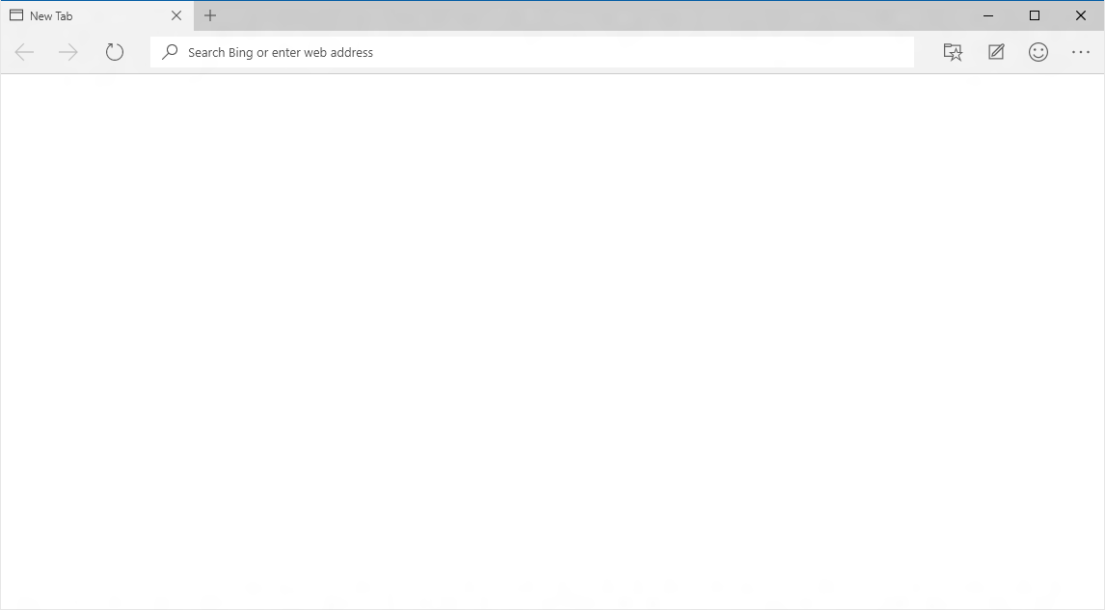
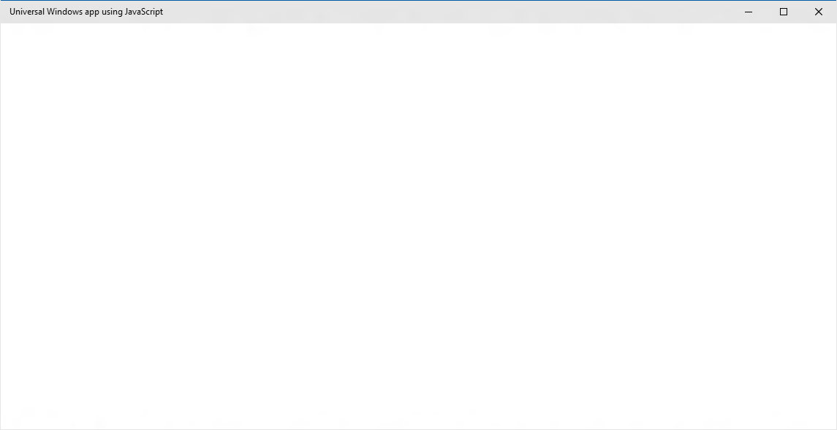
EdgeHTML.dll
Chakra
Packaged content
Offline first
Hosted content
Always up-to-date
WebView

Slide 7
WebView

Slide 8
WebView Control
Uses the always current Edge rendering engine
Improved app performance and responsiveness
Improved App to WebView communication
Enables Windows Runtime access

Slide 9
Hosted content
Always up-to-date

Slide 10
Hosted Web Apps
Your web site
To a user it looks like a regular native app they have downloaded.
The app is actually a container. We call it a Hosted Web App.
The content of the app loads dynamically from your web server
Container app
Creating a Hosted Web App takes minutes, and it’s free
Device

Slide 11
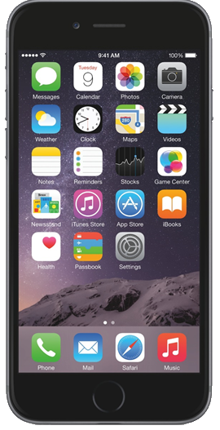
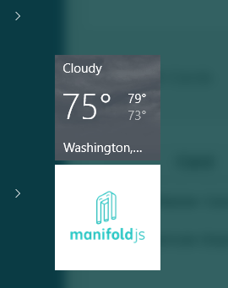
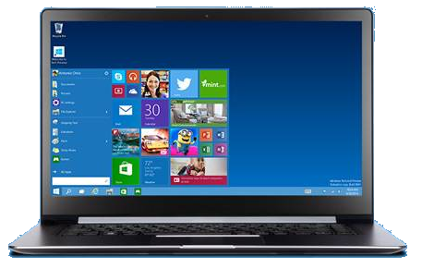


Why an App?
OS Integration
Manifoldjs

Slide 12

Why an App?
Your offline. Lets continue with our offline content
Your
App experience
Offline handling

Slide 13
Why an App?
Your offline. Lets continue with our offline content
Your
App experience
Offline handling

Slide 14
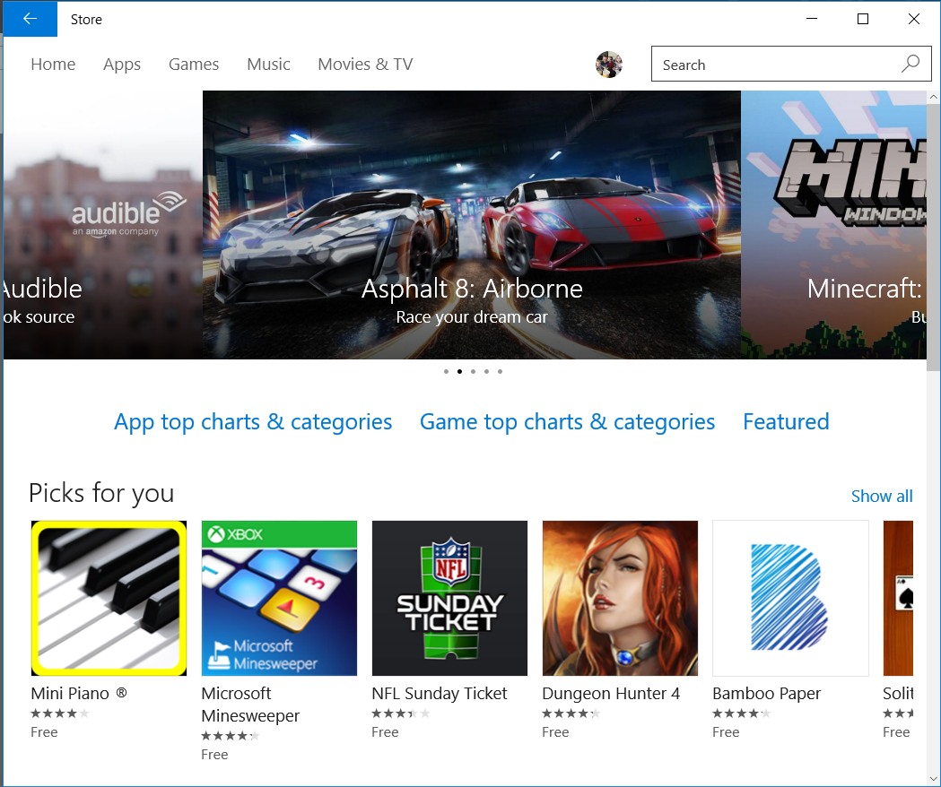
Why an App?
Store Discovery

Slide 15
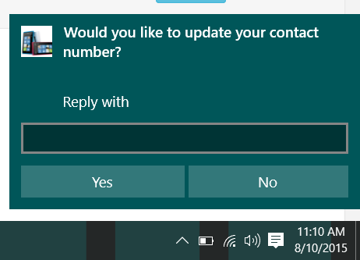
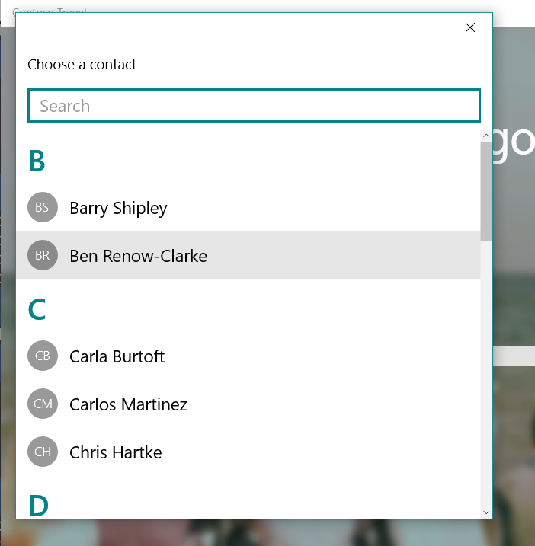
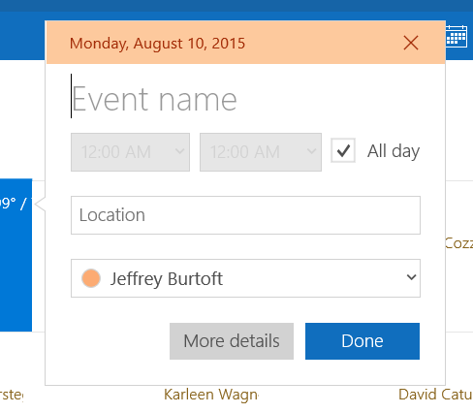
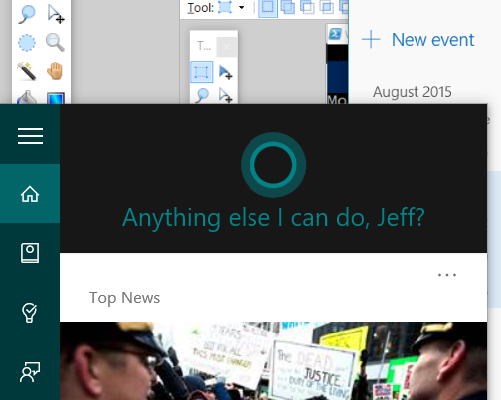
Platform APIs

Slide 16
W3C Standard
{
"name": "Super Web App",
"short_name": "SuperWA",
"start_url": "http://www.example.com",
"icons": [
{
"src": "tiny.png",
"sizes": "70x70"
},
{
"src": "square.png",
"sizes": "150x150"
},
{
"src": "apple-touch-icon-72x72-precomposed.png",
"sizes": "72x72"
},
{
"src": "niceicon.png",
"sizes": "128x128"
}
],
"display": "standalone",
"orientation": "landscape"
}
Manifest for Web Apps
http://w3c.github.io/manifest/

Slide 17








Why Manifoldjs?
The web is a mature cross platform app environment
Hosted web apps can reach all platforms at once
The tool works for developers regardless of dev environment

Slide 18

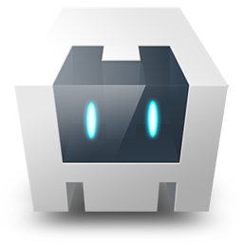

Options with Manifoldjs
Manifoldjs CLI
-node.js tool
-platform independent
Manifoldjs.com
-web based vision of CLI tool
-requires no tools to install
ManifoldCordova
-Cordova plugin
-soon to be VS template
Manifold toolkit
-Additional Cordova plugin
-provides WAT functionality
-generates Windows, iOS, android

Slide 19
Project Westminster on Windows 10
Hosted Web Apps are a First Class App in Windows 10
To a User, they appear as any other Native App
Full access to Universal APIs like
Tiles, Notifications, Camera, Contact List, Calendar
app package
HTML
CSS
JS
Platform Integrations

Slide 20
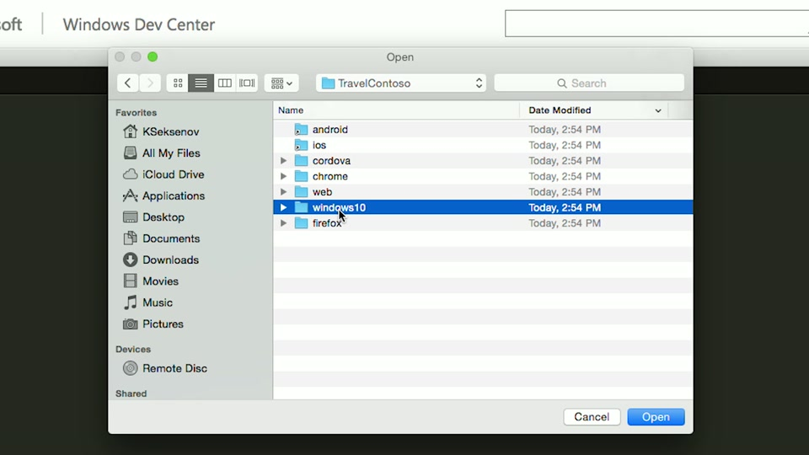
Build Apps from any PC, Linux, or Mac Machine
https://channel9.msdn.com/Blogs/One-Dev-Minute/Publishing-a-UWP-Web-App-on-a-Mac-using-ManifoldJS

Slide 21
Cross-platform, remote debugging with Vorlon.JS

Slide 22
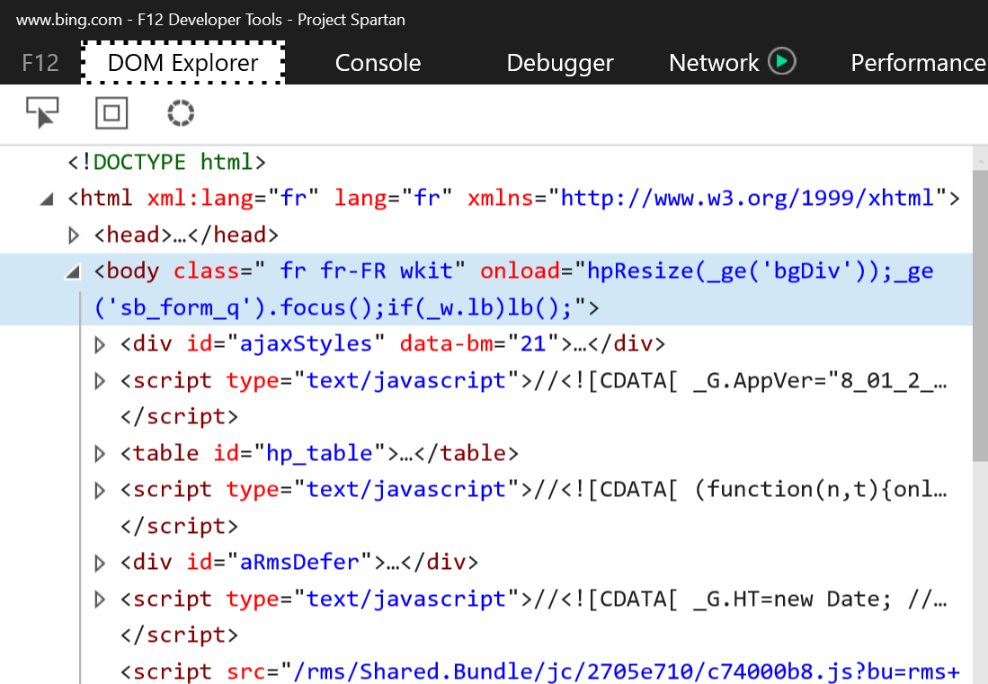
Debugging on the web
Perfect on desktop using F12 tools
Not so easy on mobile
Not built-in
Proprietary tools
Chrome to Chrome, Safari to Safari, etc.
Requires USB connection

Slide 23
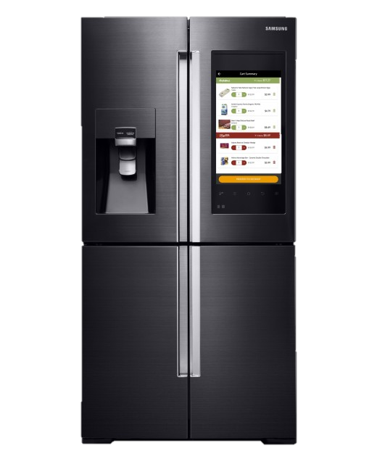
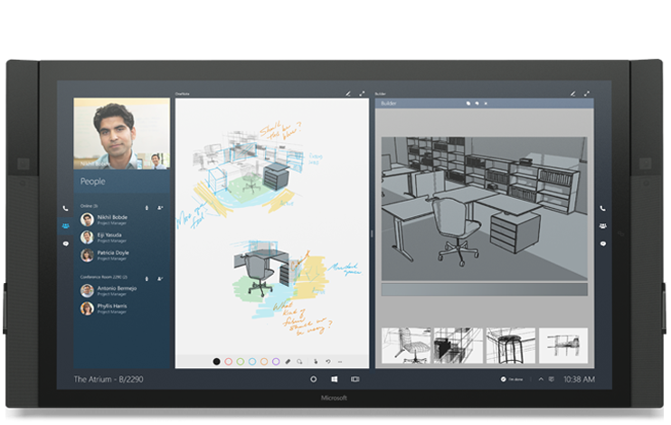
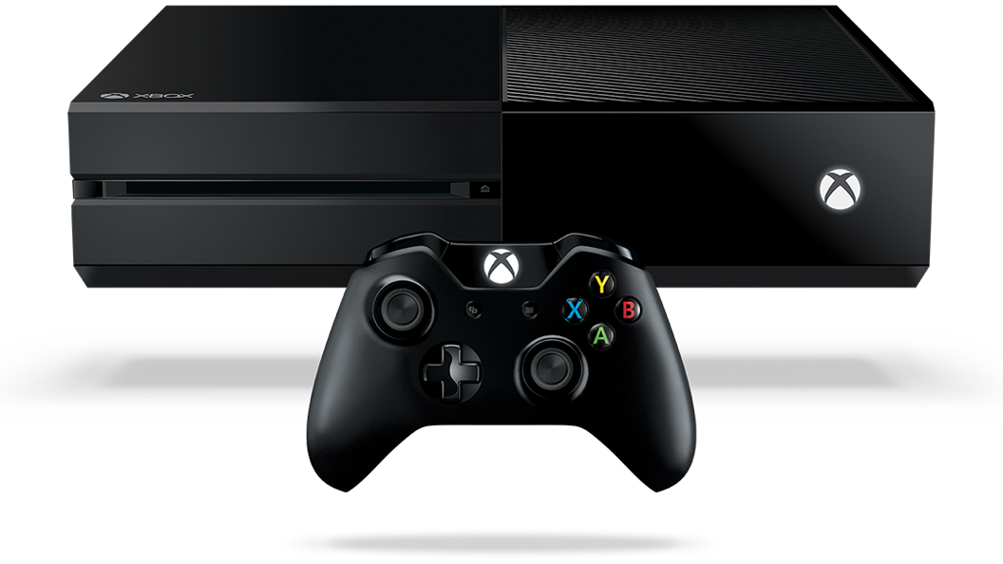
The Internet of Everything
Smart fridges, smart TVs, game consoles, web apps.

Slide 24
Debugging remotely
Instead of replicating the user’s environment to troubleshoot, why not directly hook into the specific user’s browser/device to remotely debug?

Slide 25


Slide 26
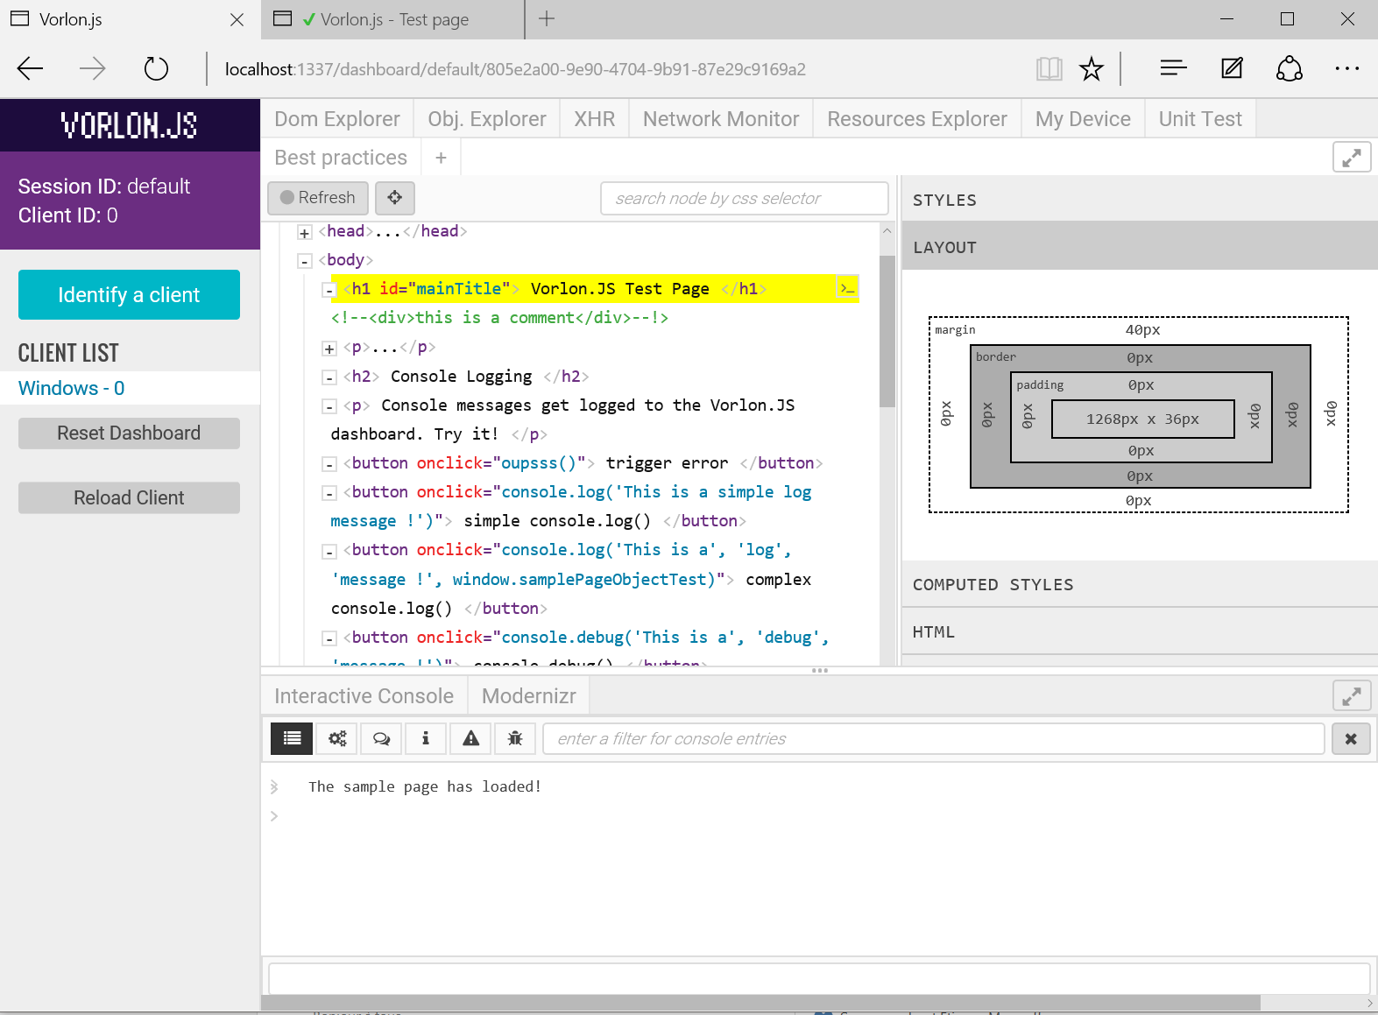
Vorlon.js – http://vorlonjs.io
Vorlon.js is :
A web remote debugging tool
Cross-browser, cross-platform
Open-source
Server - Client
Based on :
Node.js
Passport.js
Socket.io
Express.js

Slide 27
Plugins
Interactive console
DOM Explorer
Modernizr
XHR Panel
Object Explorer
Network Monitor
Resource Explorer
ngInspector
Unit tests
Best practices

Slide 28
Deploying Vorlon.JS
NPM
Azure Deploy
Desktop app (proxy)

Slide 29
Connect your client website
Modify the website code and add a script reference to a vorlon.js file generated by the server you installed
<script src="http://localhost:1337/vorlon.js"></script>

Slide 30
Vorlon.JS demo

Slide 31
http://aka.ms/webcampvorlon

Slide 32
3D in your browser

Slide 33




WebGL is…
A JavaScript API
Based on OpenGL ES 2.0
Standardized by Kronos Group

Slide 34

Using WebGL directly
You need to handle everything except the rendering
You have to:
Create shaders code
Create geometry and topology
Handle textures and resources management
Manage the render loop

Slide 35

Wireframing

Slide 36
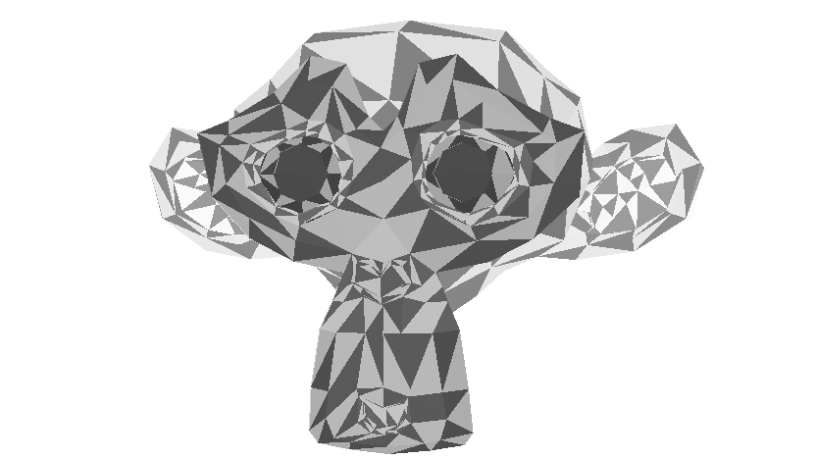
Rasterization

Slide 37
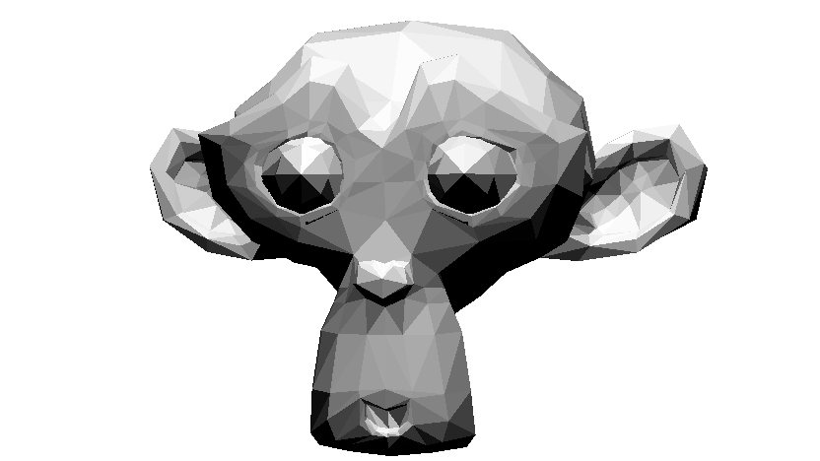
Flat Shading

Slide 38

Gouraud Shading

Slide 39

Texture mapping

Slide 40


Slide 41


Slide 42

BABYLON.JS
An average of 1 version per month 44 contributors 36 releases 1255 commits 17000+ lines of code More than 140 files of code More than 474 forks A bandwidth of 1 TB per month for the website 1.4GB (Code and samples)

Slide 43
How to use BABYLON.JS?
Open source project (Available on Github)
http://www.babylonjs.com
http://cdn.babylonjs.com/2-0/babylon.js
How to use it? Include one file and you’re ready to go!
To start Babylon.js, you’ve just need to create an engine object:
<script src="babylon.js"></script>
var engine = new BABYLON.Engine(canvas, true);

Slide 44
How to use BABYLON.JS?
Babylon.js is a scene graph: All complex features are abstracted for YOU!
Handling rendering can be done in one line:
var scene = new BABYLON.Scene(engine);
var camera = new BABYLON.FreeCamera("Camera", new BABYLON.Vector3(0, 0, -10), scene);
var light0 = new BABYLON.PointLight("Omni0", new BABYLON.Vector3(0, 100, 100), scene);
var sphere = BABYLON.Mesh.createSphere("Sphere", 16, 3, scene);
engine.runRenderLoop(function() { scene.render(); });

